Slide 1
Diffusion Model
Name | {Replace this with your name}
Identity Key | {Replace this with your identity key}
 | Level | Completed
 | Beginner | 0
 | Intermediate | 0
 | Advanced | 0
 | Expert | 0
Goal
4722 | 12
5722 | 14
Total Completed
0

Slide 2
Generating a Sentence

Slide 3
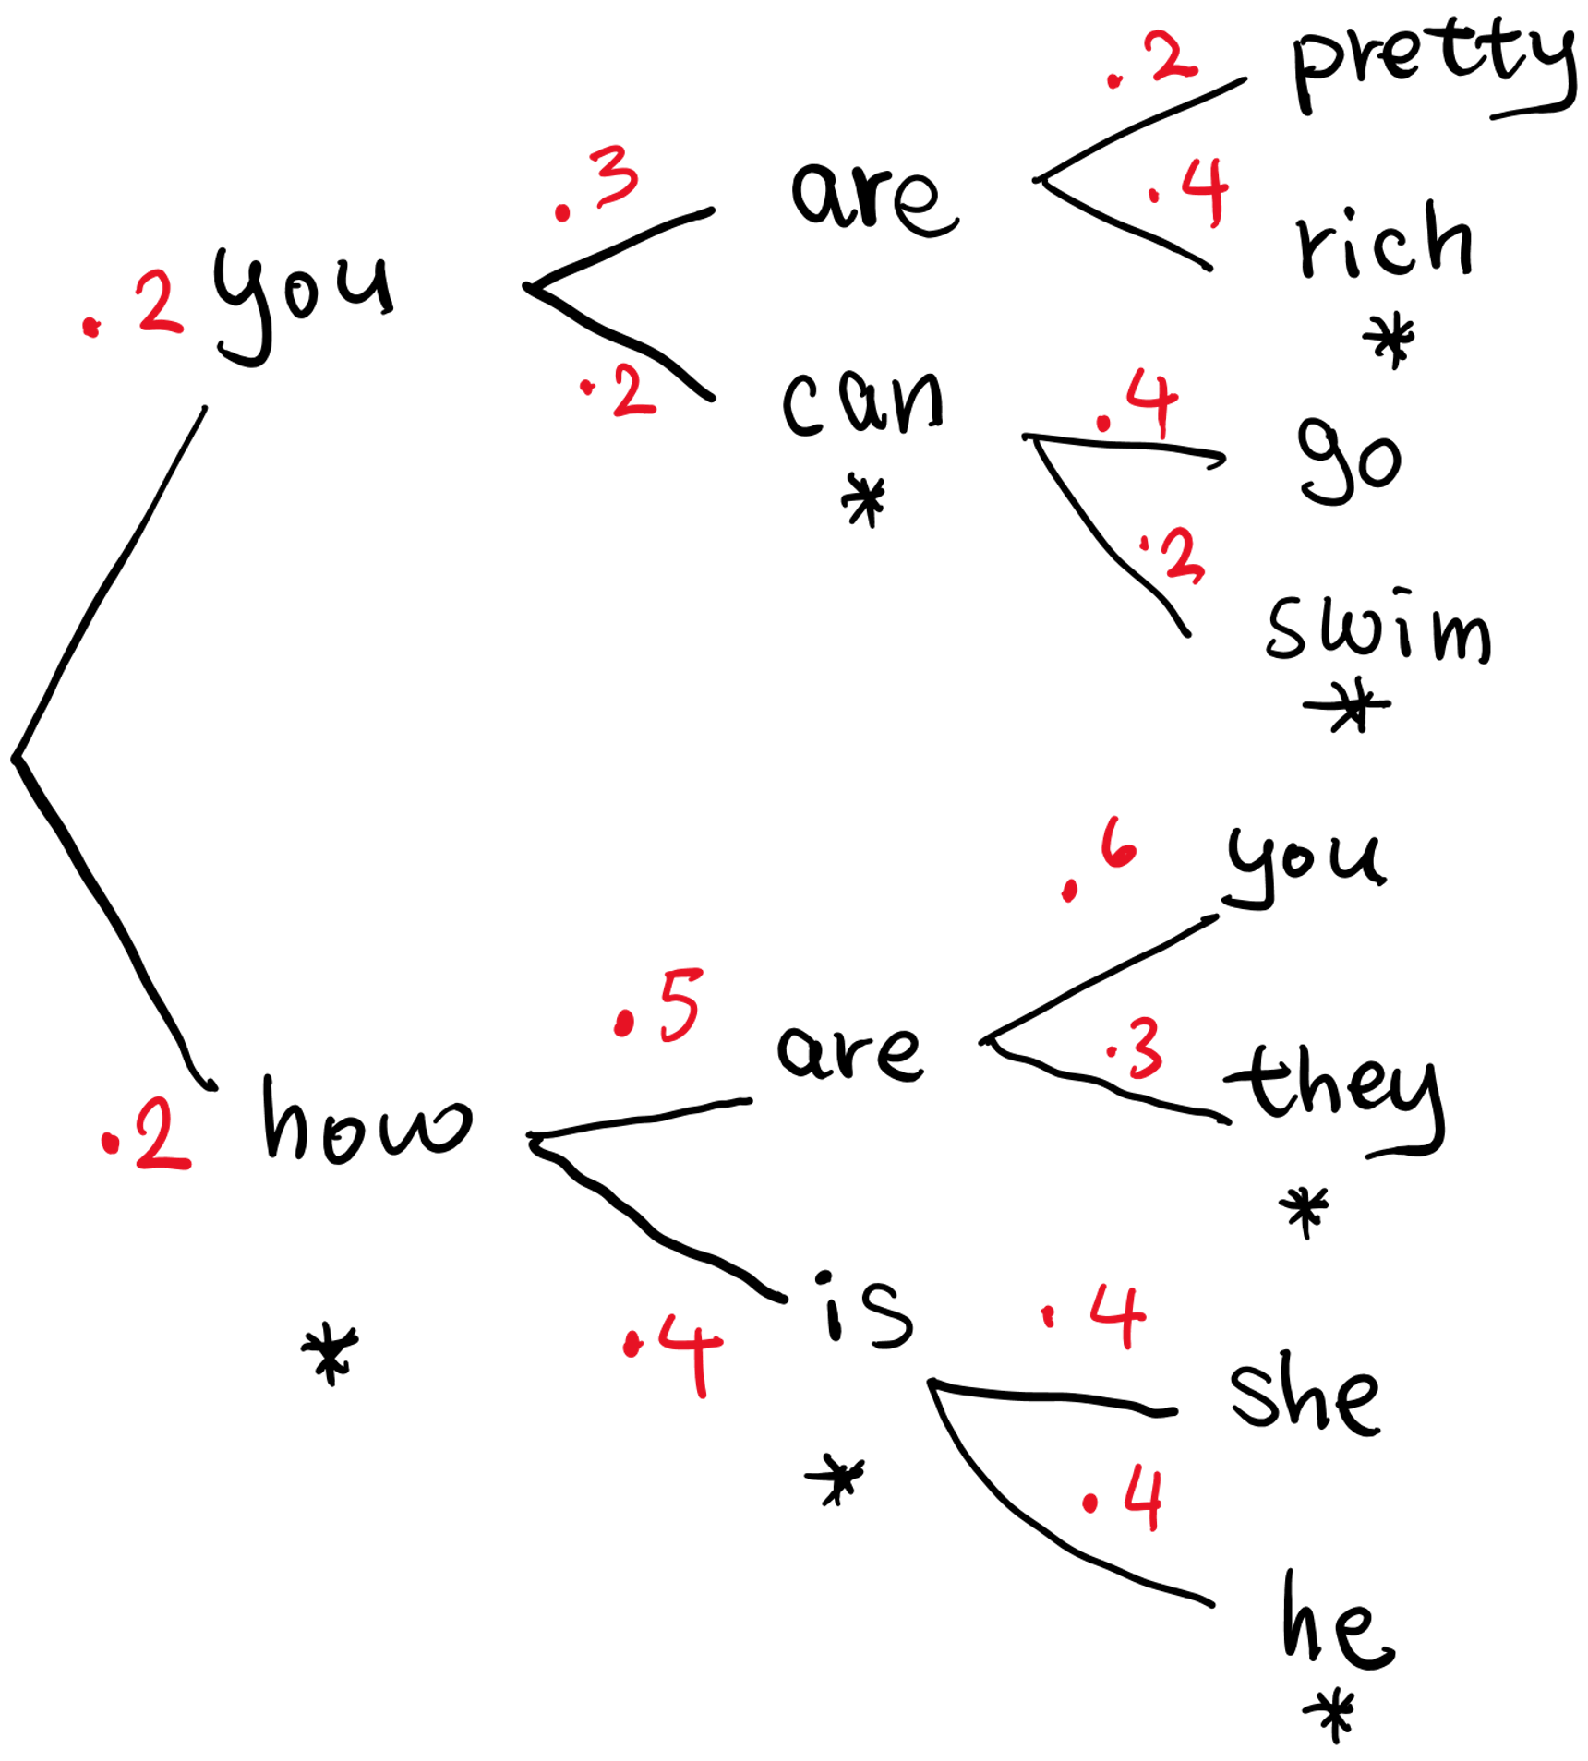
Joint Probability
a. p(“you can swim”) =
b. p(“you can go”) =
c. p(“how are they”) =
d. p(”how is she”) =
🔑 (a+b+c+d)*1000%7 = 2

Slide 4
Which sentence does this sequence of random numbers generate?
Random Number Generator
woof | 0.1
oink | 0.1
meow | 0.8
0.41 | 0.33
meow woof
woof woof
woof meow
oink woof
oink meow
woof | 0.5
oink | 0.2
meow | 0.3
woof | 0.7
oink | 0.2
meow | 0.1
woof | 0.8
oink | 0.2
meow | 0
🔑 0.3 < 0.41 < 0.5

Slide 5


Which sentence does this model generate from a random sequence of [0.6, 0.3, 0.7]?
bang | 0
boom | 0.3
pow | 0.3
zap | 0.4
pow, boom, bang
boom, pow, bang
pow, pow, bang
boom, boom, pow
bang | 0.2
boom | 0.4
pow | 0.2
zap | 0.2
bang | 0.4
boom | 0.3
pow | 0.2
zap | 0.1
bang | 0.2
boom | 0.4
pow | 0.1
zap | 0.3
bang | 0.2
boom | 0.4
pow | 0.2
zap | 0.2
bang | 0.2
boom | 0.5
pow | 0.1
zap | 0.2
bang | 0.2
boom | 0.4
pow | 0.2
zap | 0.2
🔑 bottom = 0

Slide 6
Training an Autoregressive Language Model

Slide 7
Conditional Probability
p(“woof” | “woof”) =
p(“meow” | “woof”) =
p(“woof” | “woof meow”) =
p(“meow” | “woof meow”) =
woof | meow
LM
meow | 0.7 | 0.4 | 0.2
woof | 0.3 | 0.6 | 0.8
🔑 a+b+c+d = 2

Slide 8
Joint Probability
p(“woof”) =
p(“woof meow”) =
p(“woof meow woof”) =
p(“woof meow meow”) =
woof | meow
LM
meow | 0.7 | 0.4 | 0.2
woof | 0.3 | 0.6 | 0.8
🔑 (a+b+c+d) * 100 % 5 = 4

Slide 9
Training an Autoregressive Image Model

Slide 10
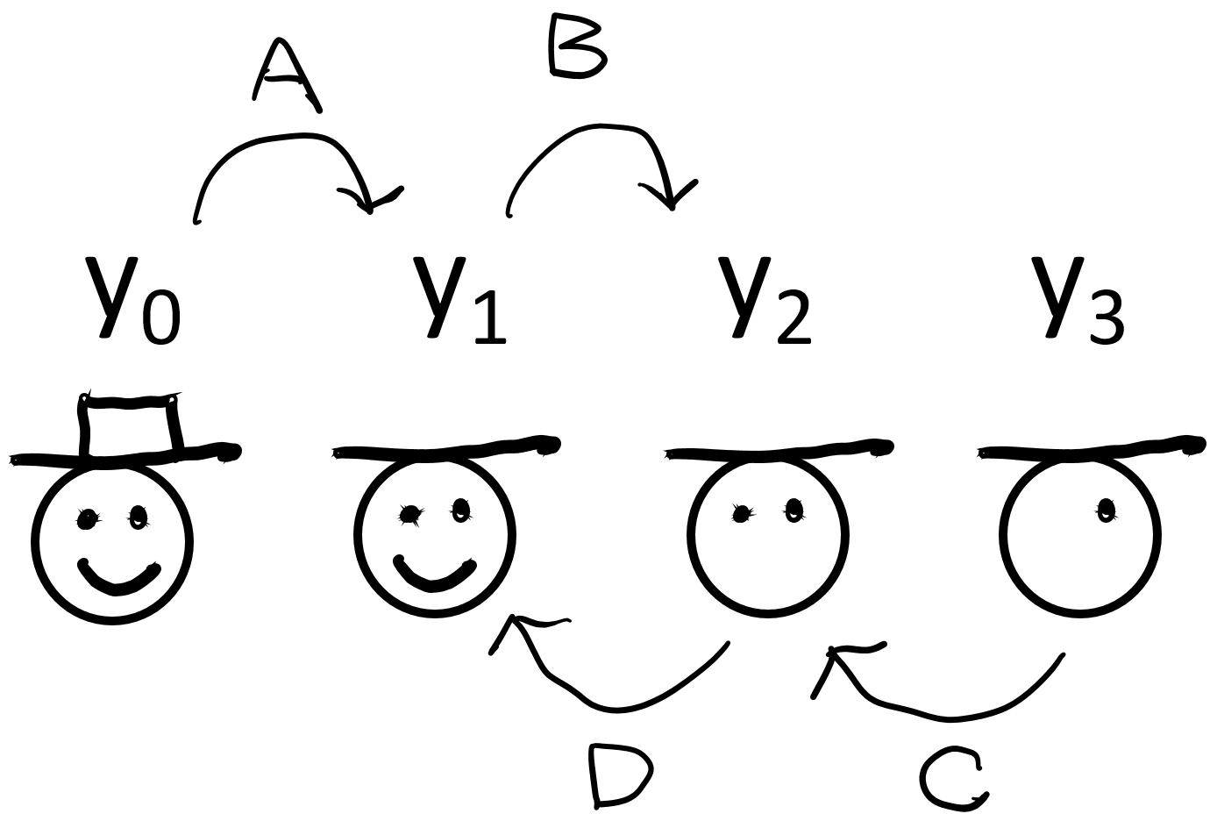
Conditional Probability Distributions
🔑 No hint: P(X2 | X1)
Write out the conditional probability distribution expression that correspond to A, B, C, D.
Enter 1 if the variable should be included.
 |  | y0 | y1 | y2 | y3 |  | y0 | y1 | y2 | y3
A. | p( |  |  |  |  | | |  |  |  |  | )
B. | p( |  |  |  |  | | |  |  |  |  | )
C. | p( |  |  |  |  | | |  |  |  |  | )
D. | p( |  |  |  |  | | |  |  |  |  | )

Slide 11
Forward
6 | 5
5 | 6
a. p(Y₁ = ) = ________
Y₁ - Y₀
Y₀
+=
1 | 0
0 | 1
0.40
5 | 5
5 | 5
4 | 5
5 | 4
-1 | 0
0 | -1
b. p(Y₁ = ) = ________
+=
0.60
Noise added
Hint: Guess which forward path leads to Y₁

Slide 12

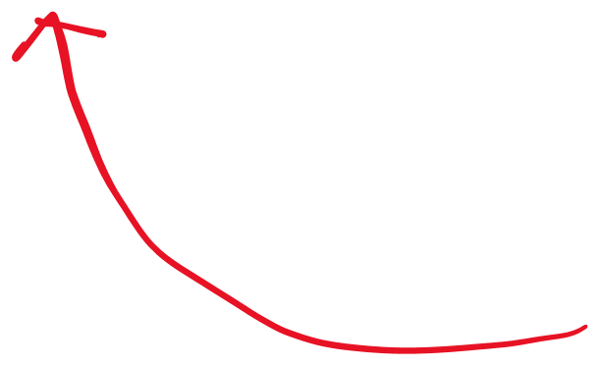
Reverse
Y₂ - Y₁
What are the pixel values of the images involved in the reverse process?
0 | 1
1 | 0
+=
0.60
Y₀
Y₁
Y₂
Y₁ - Y₀
5 | 5
5 | 5
p( | , )
0 | -1
-1 | 0
1 | 0
0 | 1
+=
0.20
Y₀
+=
0.40
5 | 5
5 | 5
-1 | 0
0 | -1
+=
0.60
0 | 1
1 | 0
+=
0.30
0 | -1
-1 | 0
+=
0.70

Slide 13



Forward
Y₂ - Y₁
🔑 (a+b)*100%11=4
0 | 1
1 | 0
+=
0.60
Y₁ - Y₀
6 | 4
4 | 6
a. p(Y₂ = ) = ________
0 | -1
-1 | 0
1 | 0
0 | 1
+=
0.20
Y₀
+=
0.40
5 | 5
5 | 5
-1 | 0
0 | -1
4 | 6
6 | 4
+=
0.60
0 | 1
1 | 0
b. p(Y₂ = ) = ________
+=
0.30
0 | -1
-1 | 0
Hint: Guess which forward path leads to Y_{2.} Calculate joint probability using the chain rule.
+=
0.70

Slide 14
Denoising Diffusion Probabilistic Model (DDPM)

Slide 15
Forward vs Reverse
During the forward diffusion process, signals are
_____ (a) {1. removed from, 2. added to} an image by
_____ (b) {1. removing, 2. adding} noises.
During the reverse diffusion process, signals are
_____ (c) {1. removed from, 2. added to} an image by
_____ (d) {1. removing, 2. adding} noises.

Slide 16
NumPy by Hand ✍️ [Math → For Loops]

Slide 17
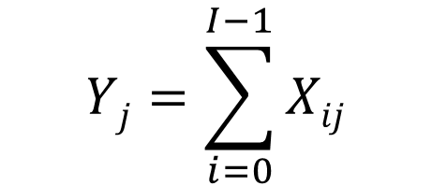
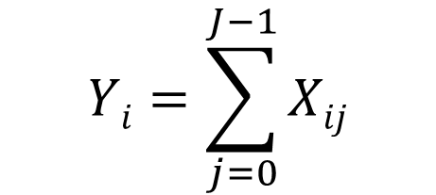
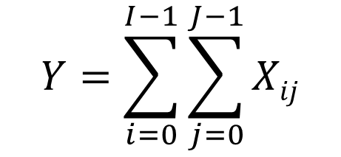
Match math to code
(a)
(b)
(c)
$$Yj=\sum_{i=0}^{I−1}{Xij}$$
$$Y=\sum_{i=0}^{I−1}{\sum_{j=0}^{J−1}{Xij}}$$
$$Yi=\sum_{j=0}^{J−1}{Xij}$$
(1)
(2)
(3)
I, J = X.shape
Y = np.zeros((I,J))
for i = range(I) :
for j = range(J):
Y[j] += X[j,i]
I, J = X.shape
Y = np.zeros((I,J))
for i = range(I) :
for j = range(J):
Y[i] += X[j,i]
I, J = X.shape
Y = 0
for i = range(I) :
for j = range(J):
Y += X[i,j]

Slide 18
What are the indices?
D_{kl} = Σ Σ A_{ij}B_{jk}C_{kl}
_____
_____
a
b
D_{ik} = Σ Σ A_{ij}B_{jk}C_{kl}
_____
_____
c
d

Slide 19
Math → Code
D_{ij} = Σ Σ A_{ij}B_{jk}C_{kl}
I, J = A.shape
J, K = B.shape
K, L C.shape
D = np.zeros((______, _______))
for i = range(I) :
for j = range(J):
for k = range(K):
for l = range(L):
D[___,___] += A[___,___] * B[___,___] * C[___,___]
a
b

Slide 20
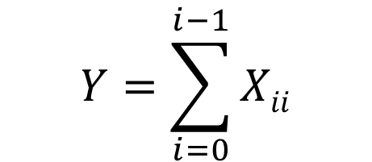
Math → Code → Calculate by hand
Complete the two missing lines of code
Given X, what is Y?
$$Y=\sum_{i=0}^{i−1}{Xii}$$
I, I = X.shape
Y = _________________
for i = range(I):
___________________________
3 | -5 | 4
2 | 2 | 0
8 | 5 | 1
a
X =
b
c
Y = __________

